Slide 1
RISHVANTH A
TEAM - 3
STOCK TREND PREDICTION AI

Slide 2
Introduction
Machine Learning Model that predicts the next day's closing price using historical data of Stock values

Slide 3
Problem Statement
Stock markets generate large historical data, but predicting future prices is difficult due to market volatility and complex patterns.
This project develops an AI-based model that analyzes past stock data to predict future stock trends using ML.

Slide 4
Abstract
This project builds a ML model to predict short-term stock trends using historical price and volume data. Raw data is cleaned and preprocessed, with lag features and moving averages engineered to capture short- and medium-term patterns.
A Random Forest regression model is trained using a time-based split and evaluated with MAE, RMSE, and R² to quantify performance.
Model and scaler artifacts are persisted and integrated into a lightweight Flask dashboard that visualizes Actual vs Predicted values.
The prototype demonstrates a reproducible workflow for trend prediction and highlights next steps, including models, to improve accuracy

Slide 5
Solution
AI-based stock trend prediction system that uses historical stock market data.
ML algorithms used to learn patterns from past prices and predictions for future stock trends.
Predicted results are visualized through a dashboard to help users understand stock.

Slide 6
Technologies stack
Python – Main programming language used for data processing and model development
Pandas & NumPy – Data cleaning, preprocessing, and numerical operations
Scikit-learn – Machine learning model training (Random Forest)
Flask – Backend framework to build the dashboard interface
Matplotlib / Seaborn – Data visualization and prediction graphs

Slide 7
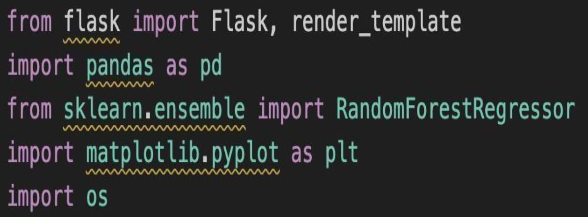
LIBRARIES USED

Slide 8
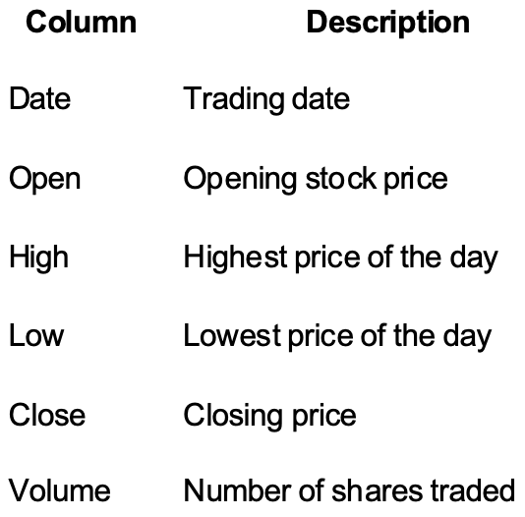
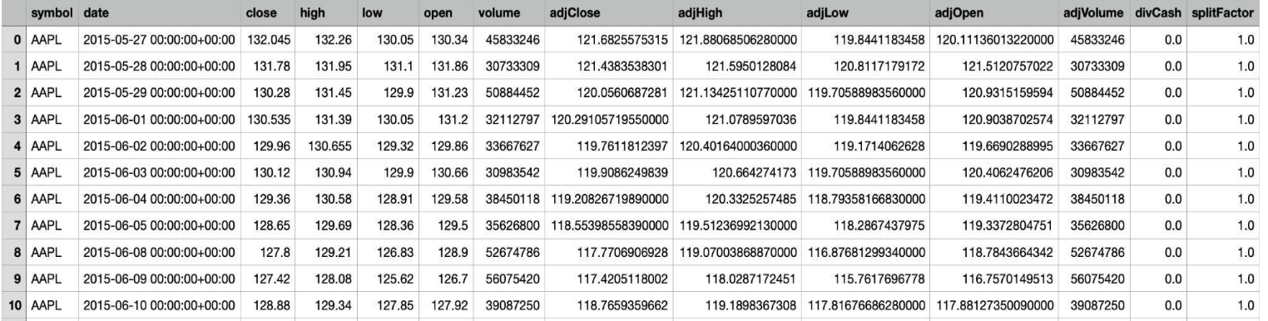
DATASET AND INFORMATIONS

Slide 9
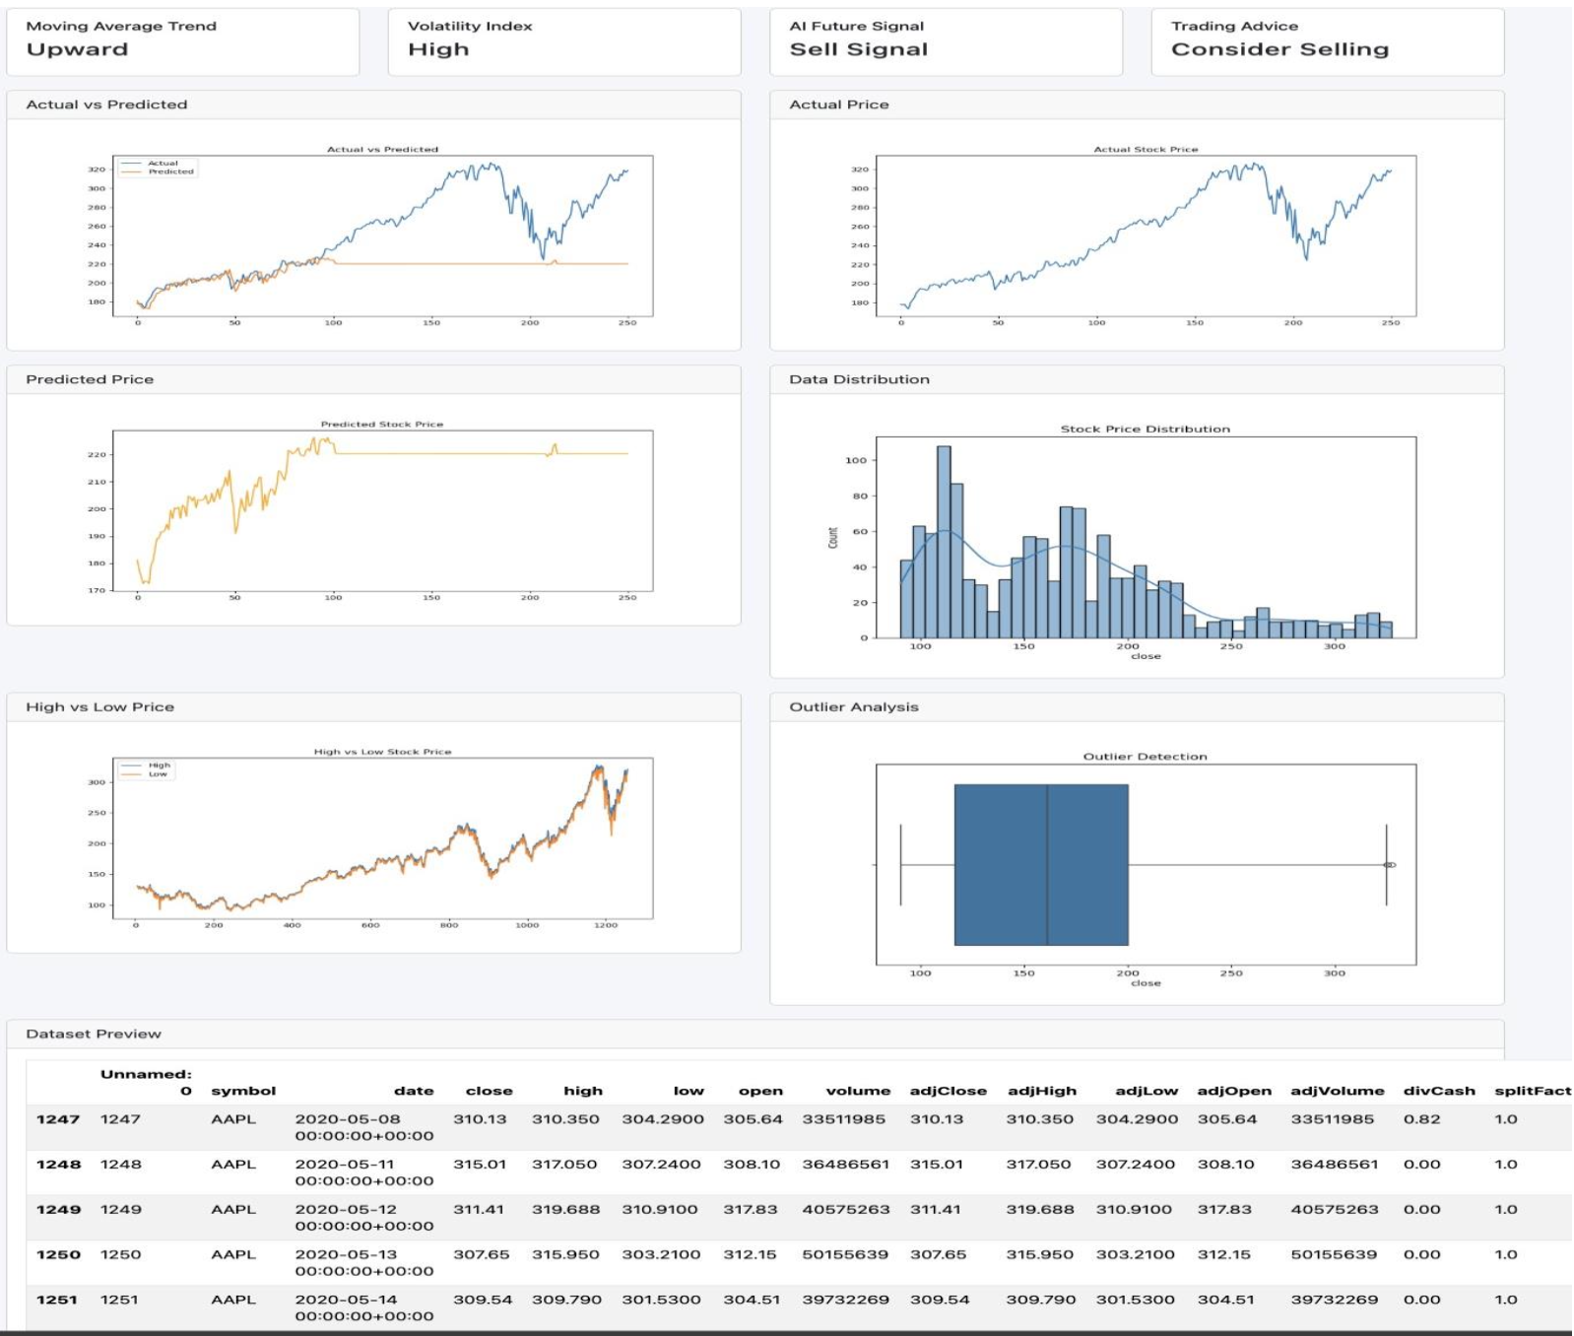
OVERALL DASHBOARD

Slide 10
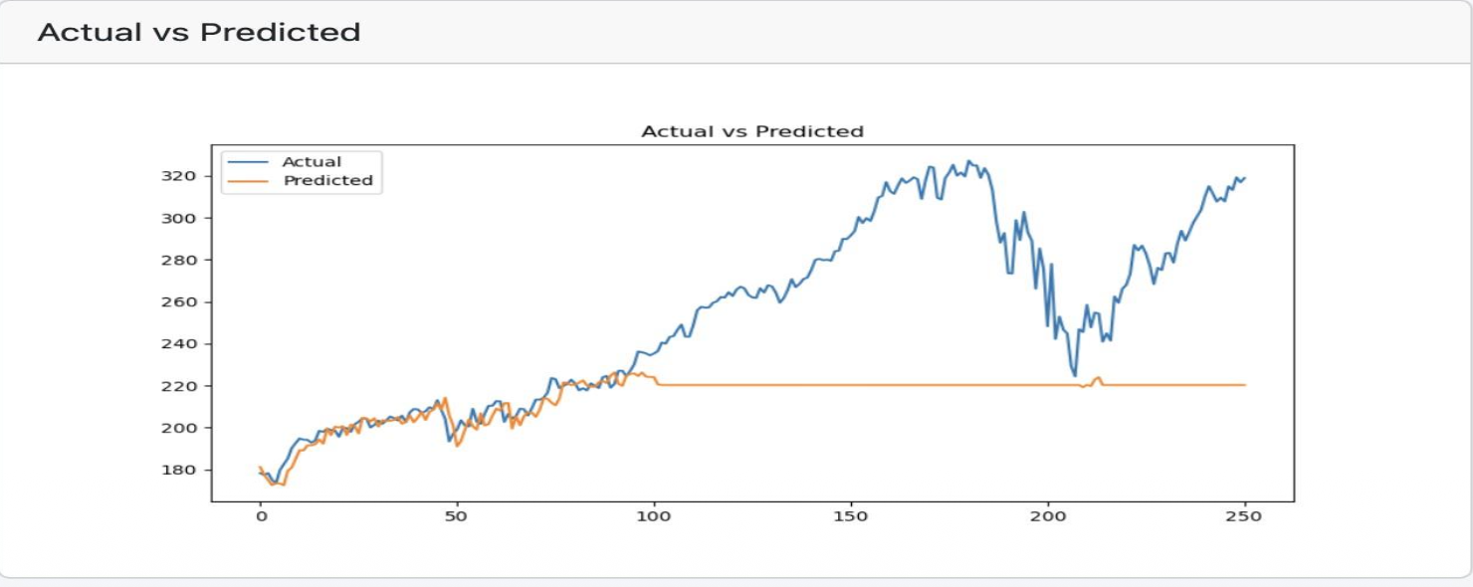
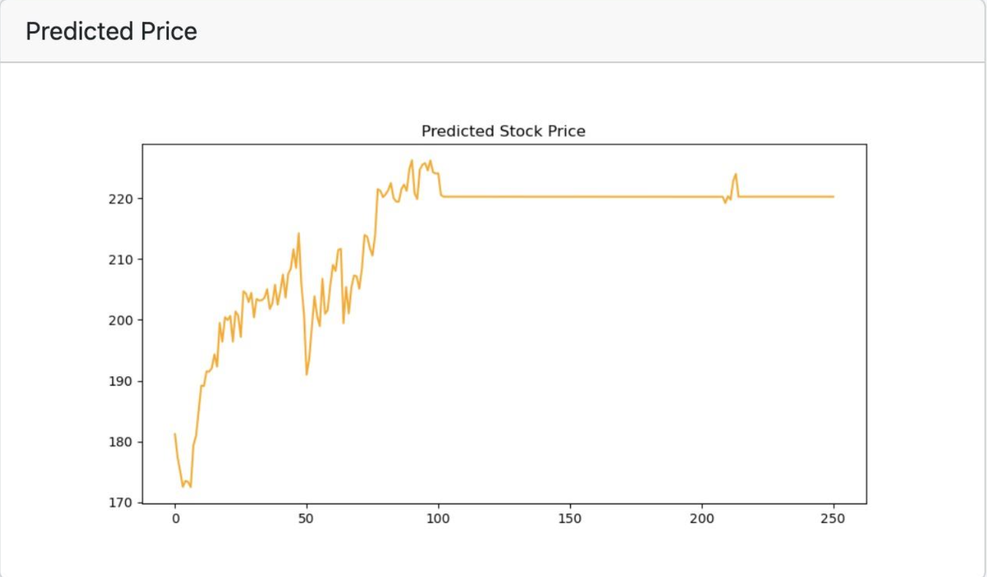
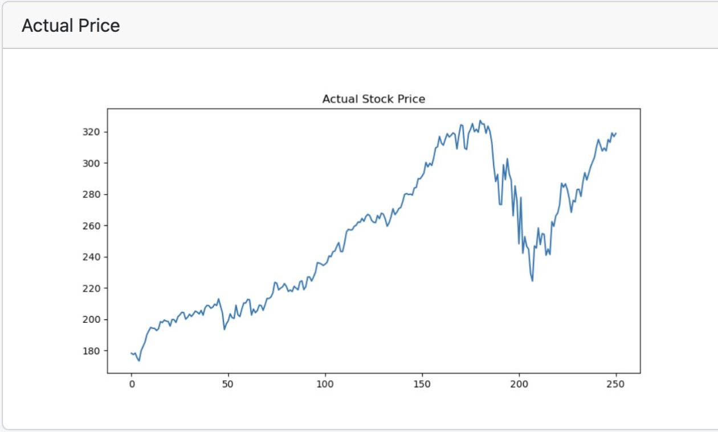

Slide 11
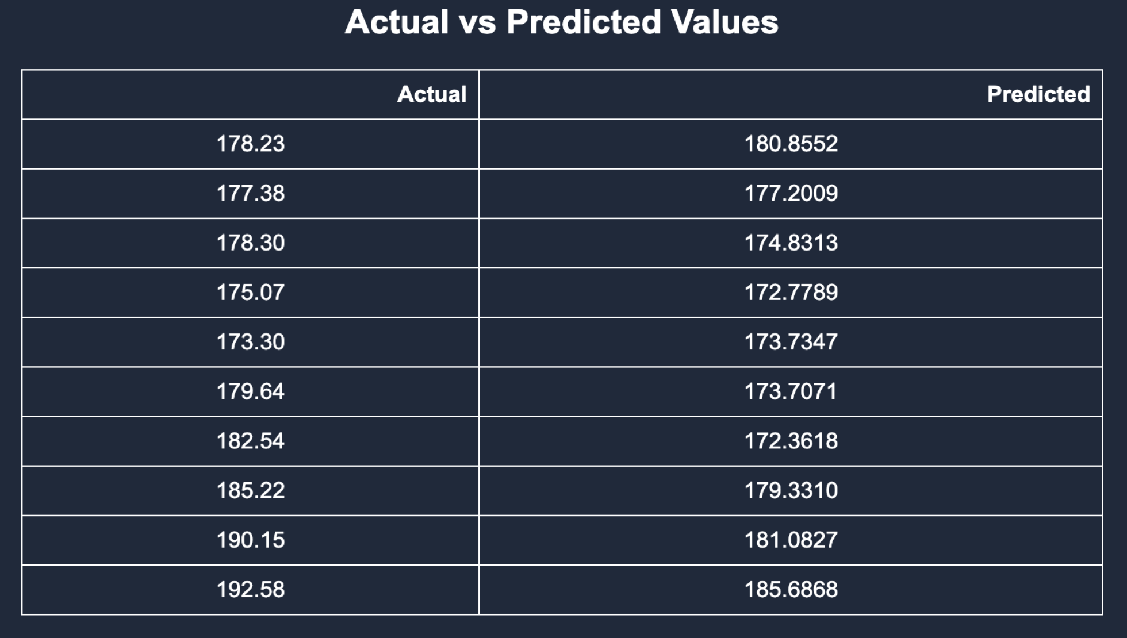
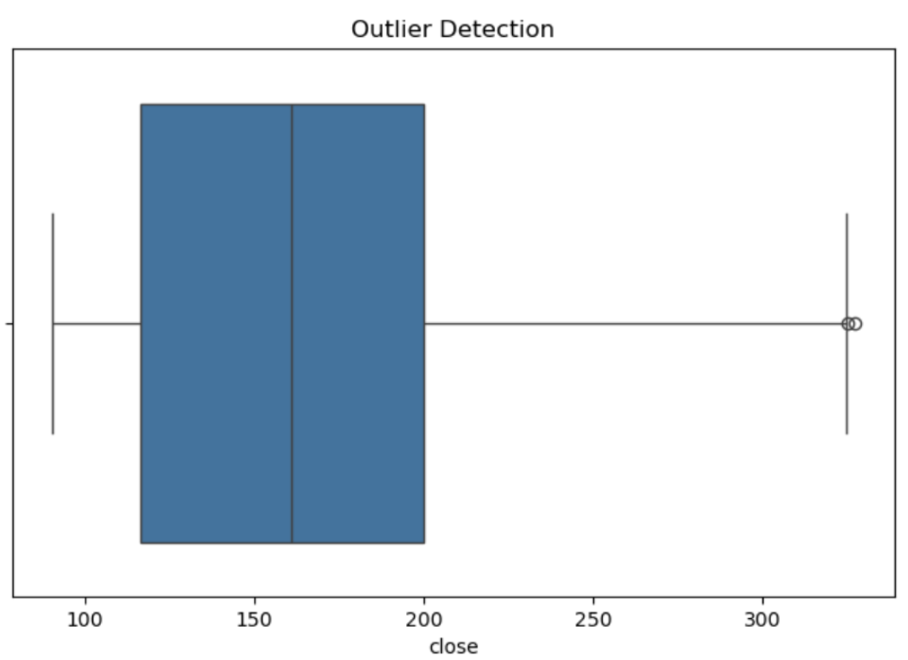
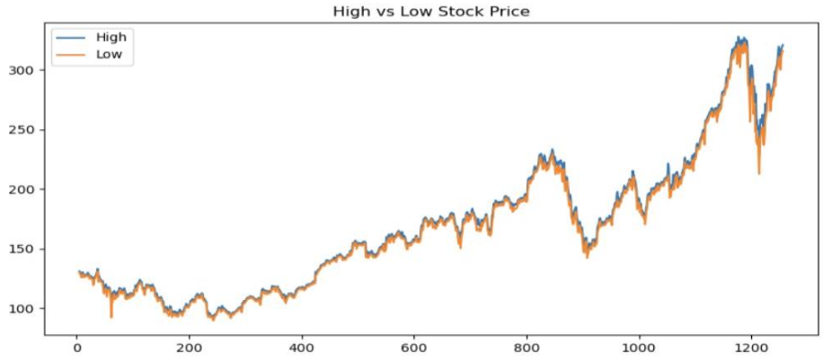
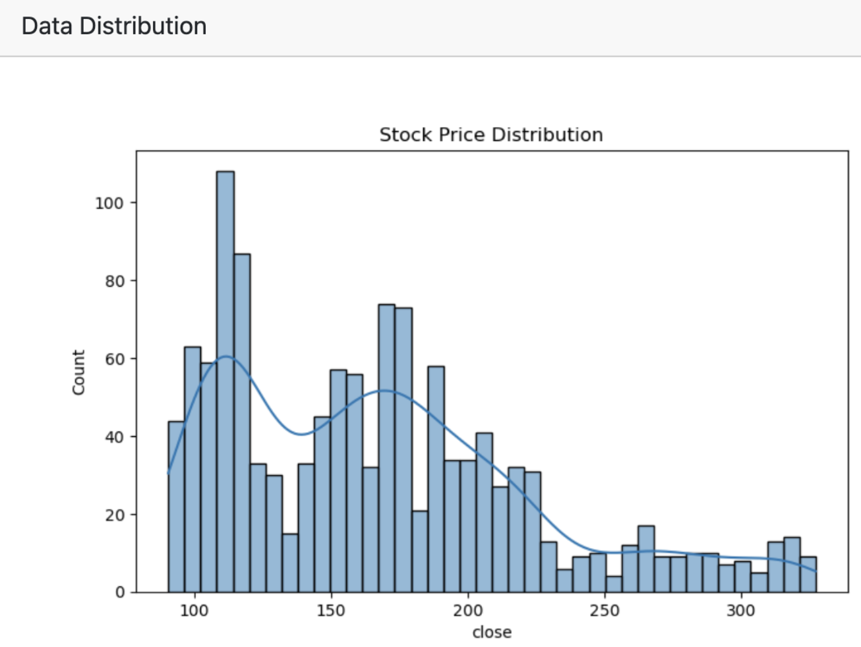

Slide 12
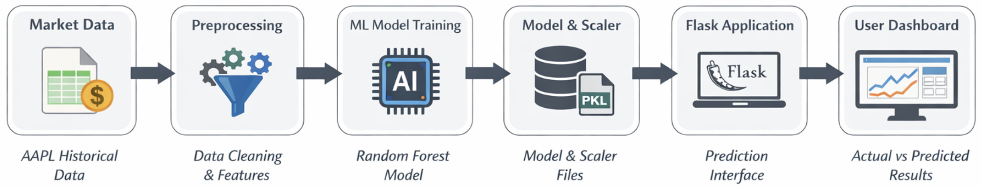
Architect diagram

Slide 13
Feature enhancement
1. Integration of advanced machine learning models, such as LSTM or XGBoost, to improve prediction accuracy.
2. Addition of real-time stock data to provide live trend predictions.
3. Development of a more interactive dashboard with detailed visualizations and stock trend graphs.
4. Ability to support multiple stock symbols instead of analyzing only one company.

Slide 14
Advantages
Helps analyze historical stock data to identify market trends.
Uses machine learning to provide more data-driven predictions.
Visual dashboard makes stock trend insights easy to understand.

Slide 15
Core Modules
Data Collection & Preprocessing: Collects historical stock data and cleans it for analysis.
Machine Learning Model: Trains the model using historical data to predict stock trends.
Prediction & Visualization: Displays predicted results and stock trends through graphs on the dashboard.

Slide 16
Conclusion
This project shows how ML can be used to analyze historical stock data and predict future trends.
This system helps users understand stock trends through data-driven predictions and visual insights.
Overall, it shows the potential of AI in supporting smarter stock market analysis and decision-making.

Slide 17
THANK YOU

